Slide 1
Intro to Data Visualization Theory
Prof. Jean Fan

Slide 2
Announcements
Thanks to everyone for reflection
Slides are available on course website
Generally we won’t use slides
My doodles with 3 points not great
I will try code slower
Kalen to have office hours after class => tutorials on Git, etc
Center for Computational Biology 2nd floor
New students
Please join course Slack
Recordings of previous lecture
Homework 0 -> please do so
Precourse survey: bit.ly/GDV23_presurvey

Slide 3
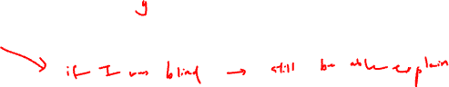
Lesson learning objectives
Establish a common vocabular for discussing data visualization
To be able to communicate with each other about properties of data visualization
Be interactive
Begin programming in R

Slide 4
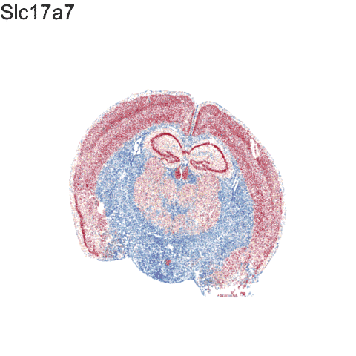
What is data visualization?
Data visualization == “the graphical display of data”

Slide 5
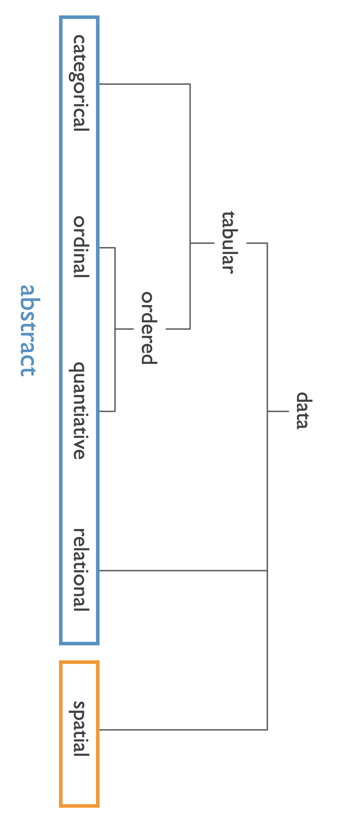
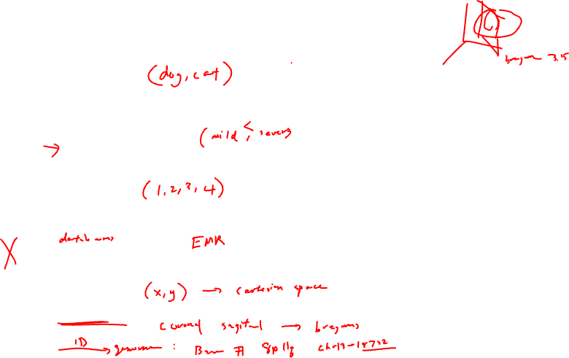
Data types
Categorical data represent qualitative characteristics. Categorical data can take on numerical values, but those numbers don’t have mathematical meaning.
Ordinal data represent mixes numerical and categorical data. The data fall into categories, but the numbers placed on the categories have meaning.
Quantitative data represent numerical values. Values can be interpreted mathematically.
Relational data represent how numerical and categorical data are related
Spatial data represents information about the physical location and shape

Slide 6
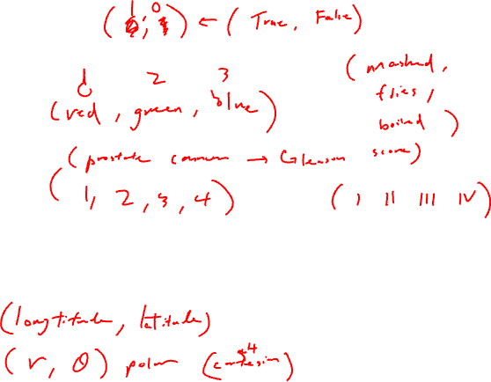
Examples
Categorical:
Ordinal:
Quantitative:
Spatial:

Slide 7
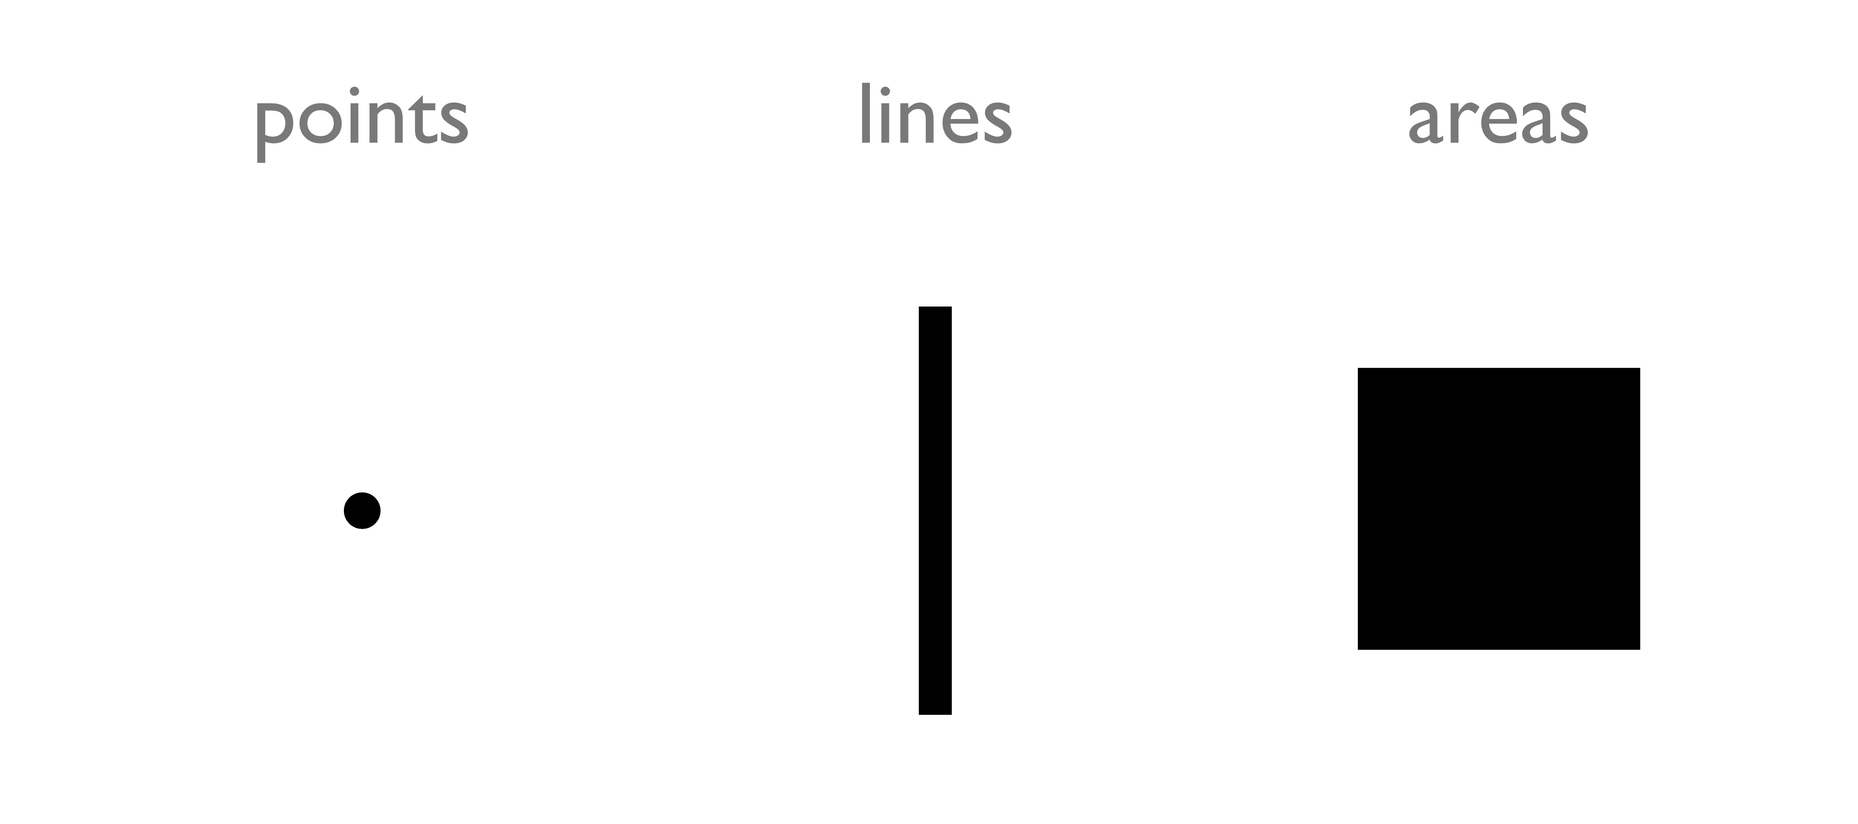
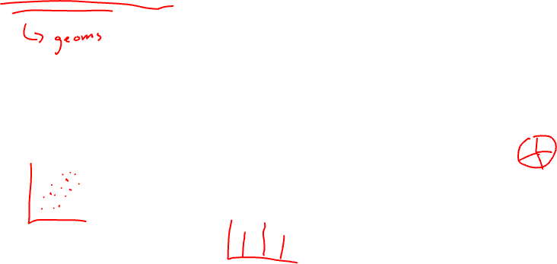
Types of encodings for different data types: Geometric Primitives
(Credit: Nils Gehlenborg, ISMB/ECCB 2011)

Slide 8
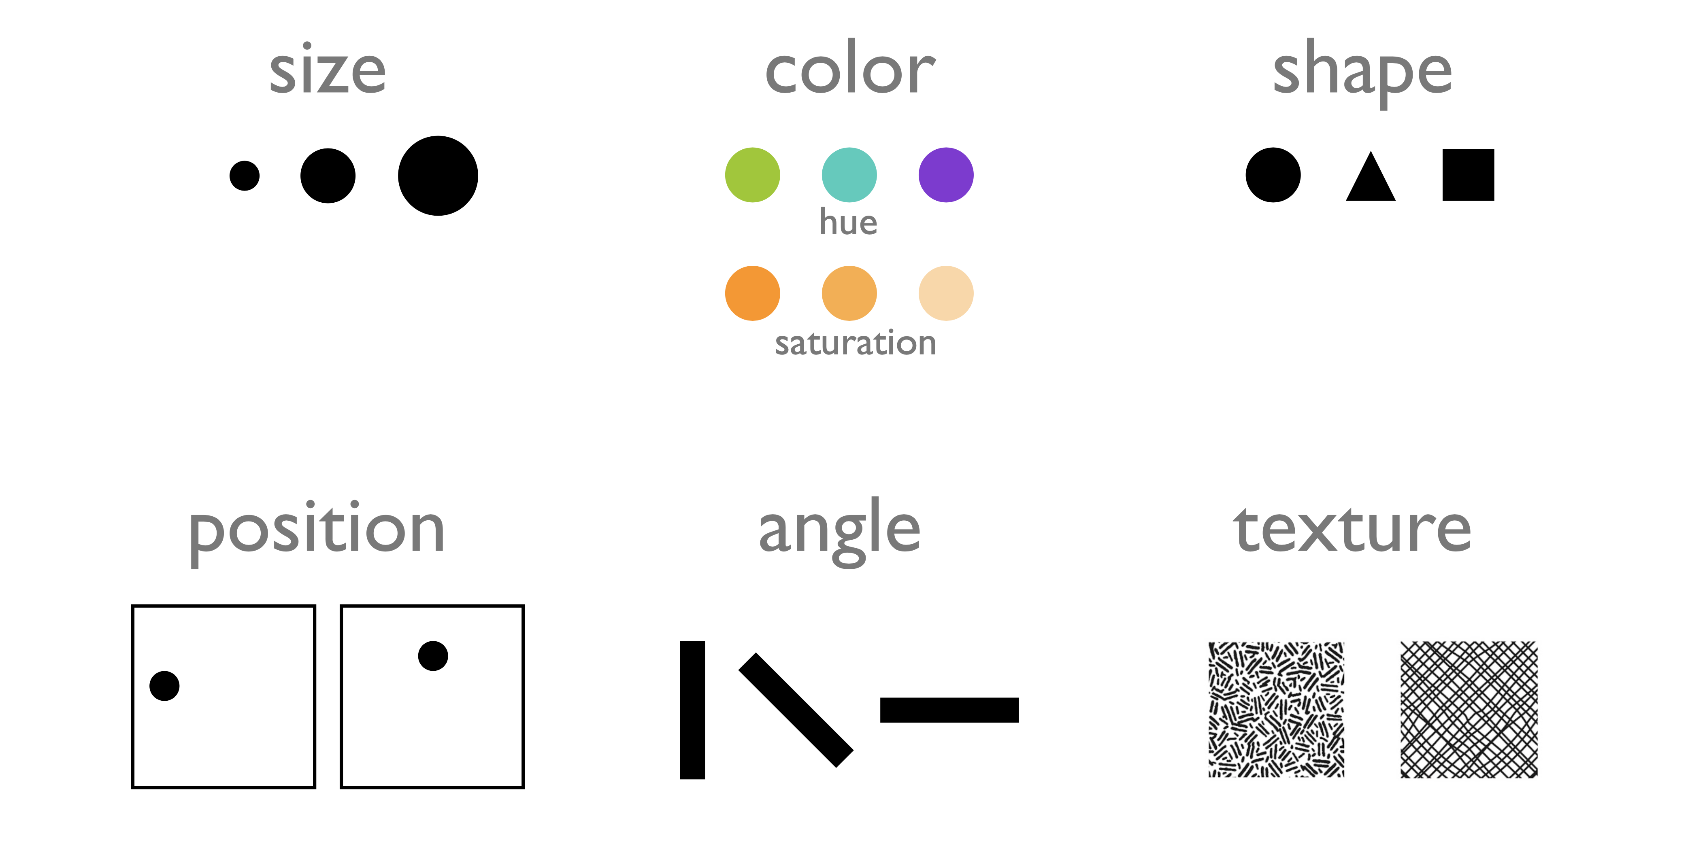
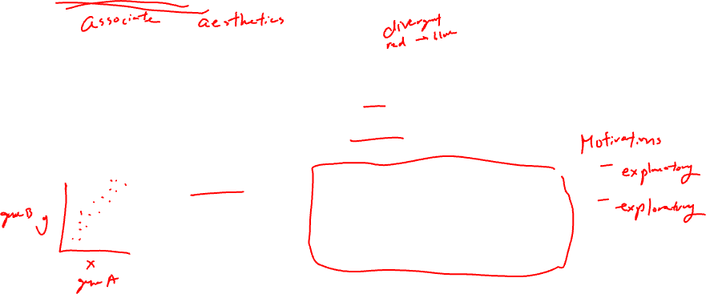
Types of encodings for different data types: Visual Channels (control geometric primitives)
(Credit: Nils Gehlenborg, ISMB/ECCB 2011)

Slide 9
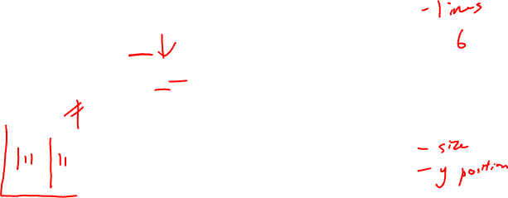
Data visualizations use combinations of geometric primitives and visual channels
Practice
Geometric primitive:
Visual channels:

Slide 10
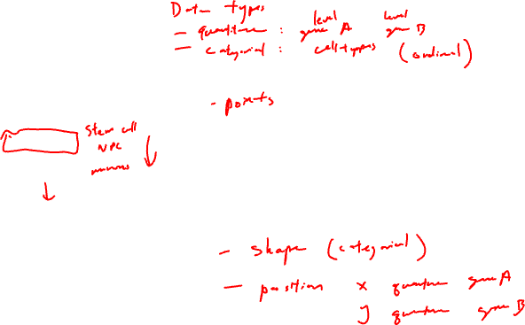
Data visualizations use combinations of geometric primitives and visual channels
Practice
Geometric primitive:
Visual channels:

Slide 11
Gestalt Principles
Gestalt Principles are an essential part of visual design (generally, not just data visualization)
There are more than ten overlapping principles
We will focus a few most applicable to data visualization
Basic on perception and cognitive psychology research

Slide 12
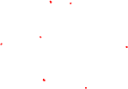
Gestalt Principle: Similarity
Items alike in their properties (size, shape, color, and so on) tend to be perceived as being a related group

Slide 13
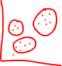
Gestalt Principle: Similarity
Practice
Items alike in their properties (size, shape, color, and so on) tend to be perceived as being a related group
How does this data visualization use the Gestalt principle of similarity?

Slide 14
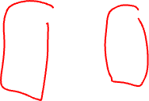
Gestalt Principle: Proximity
Items are near each other tend to be perceived as being a related group

Slide 15
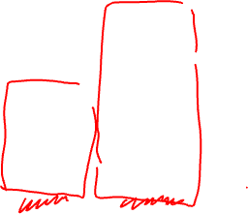
Gestalt Principle: Proximity
Practice
Items are near each other tend to be perceived as being a related group
How does this data visualization use the Gestalt principle of proximity?

Slide 16
Gestalt Principle: Enclosure
Items surrounded by something such as a line or an an object tend to be perceived as being a group

Slide 17
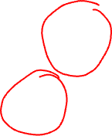
Gestalt Principle: Enclosure
Practice
Items surrounded by something such as a line or an an object tend to be perceived as being a group
How does this data visualization use the Gestalt principle of enclosure?

Slide 18
Gestalt Principle: Enclosure
Practice
Items surrounded by something such as a line or an an object tend to be perceived as being a group
How does this data visualization use the Gestalt principle of enclosure?

Slide 19
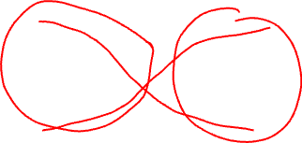
Gestalt Principle: Continuity
Elements tend to be perceived as smooth groups or continuous lines rather than sharp broken lines

Slide 20
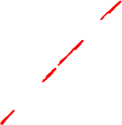
Gestalt Principle: Continuity
Practice
Elements tend to be perceived as smooth groups or continuous lines rather than sharp broken lines
How does this data visualization use the Gestalt principle of continuity?

Slide 21
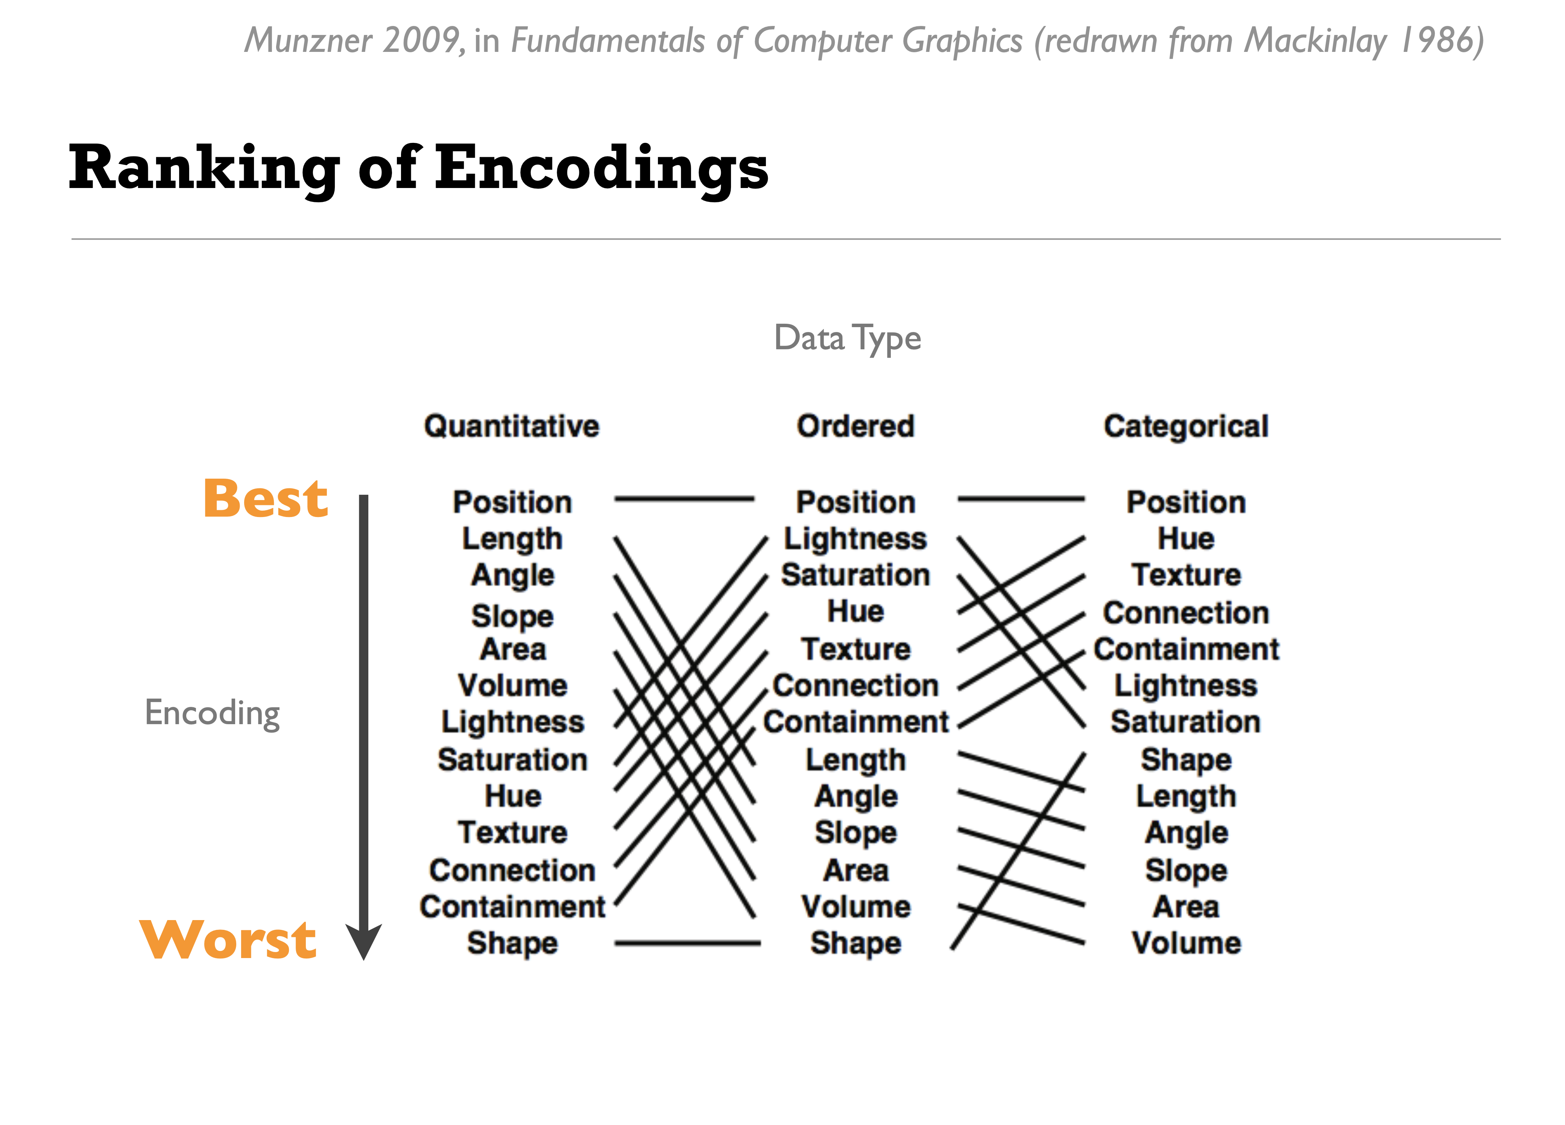
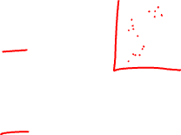
Human perception has a harder time resolving certain data encodings for different data types
(Credit: Nils Gehlenborg, ISMB/ECCB 2011)

Slide 22
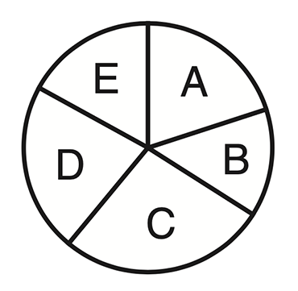
Demo: Which letter is more common?
(Credit: Bang Wong, Nature Methods, 2010)
Notes:
Different graph types depend on different visual assessments to uncover underlying trends. Pie charts are a common way to show parts of a whole. Most readers will likely judge angle when extracting information from pie charts, but they could also com- pare areas and arc length of the slices. Plotting the same data as a bar chart effectively shows relative values.

Slide 23
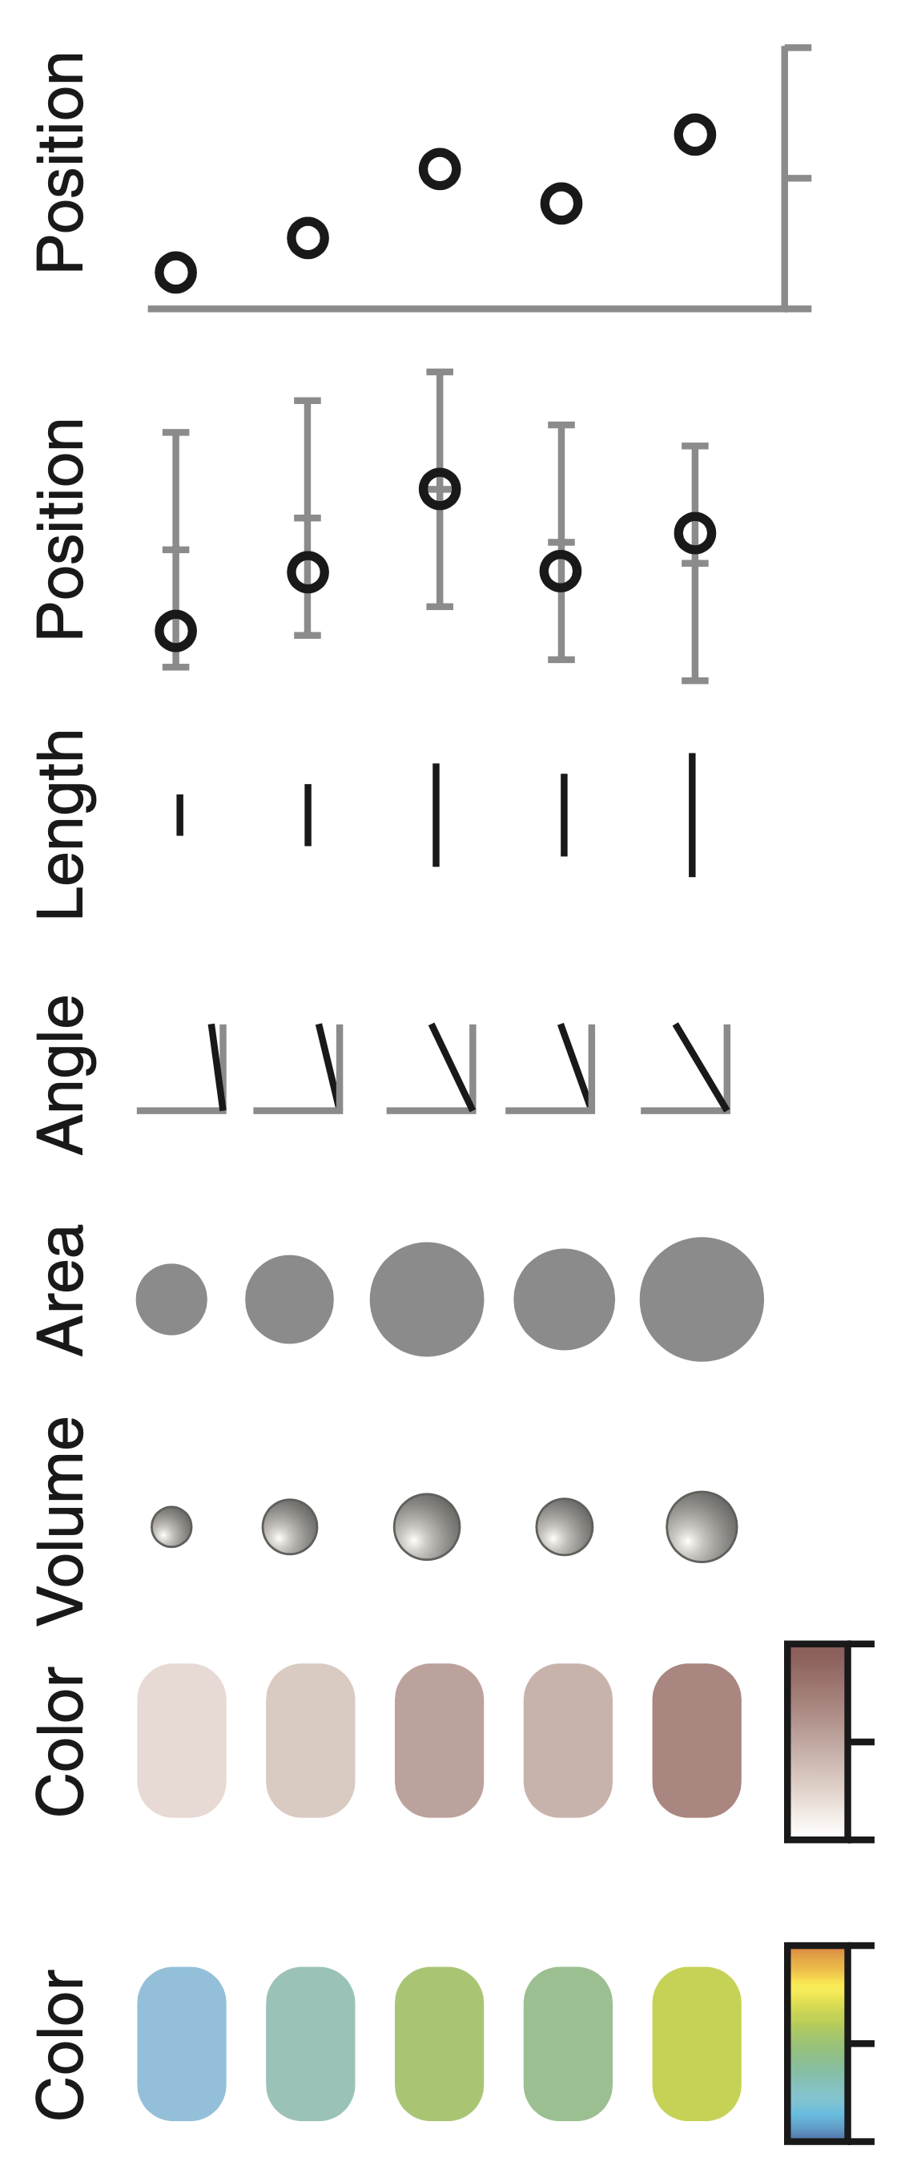

(Credit: Bang Wong, Nature Methods, 2010)

Slide 24
Salience
Salience (in data visualization) is how the viewer's eye is drawn to what is important in the data visualization
Enhanced saliency improves viewer understanding of the data
How accurately can the data be read from the visualization?
How many classes can be distinguished?
Can the visual properties and geometric primitives be separated from each other?
Which visual properties and geometric primitives are processed preattentively?
Which visual properties and geometric primitives encode more important information more effectively?
A good data visualization enhances saliency

Slide 25
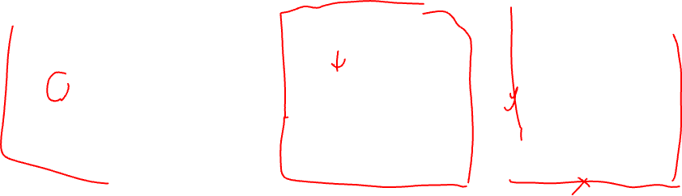
How do these different data visualizations enhance saliency of different features?
Practice

Slide 26
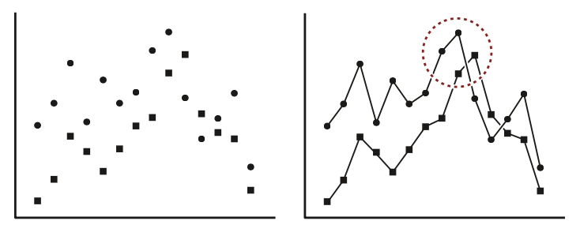
What’s your interpretation of this data visualization?
Practice

Slide 27
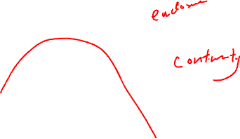
What about this one?
Practice
What gestalt principals are being applied?

Slide 28
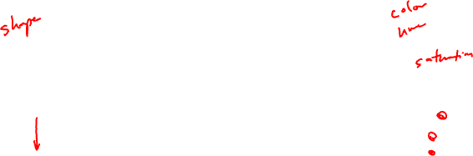
Which data visualization do you prefer? Why?
Practice

Slide 29
Which data visualization do you prefer? Why?
Practice

Slide 30
Practice

Slide 31

Is data visualization an art or a science?

Slide 32
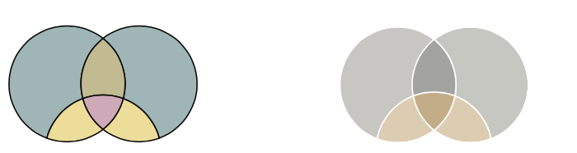
Which data visualization do you prefer? Why?
Practice
(Credit: Martin Krzywinski, Nature Methods 2013)

Slide 33
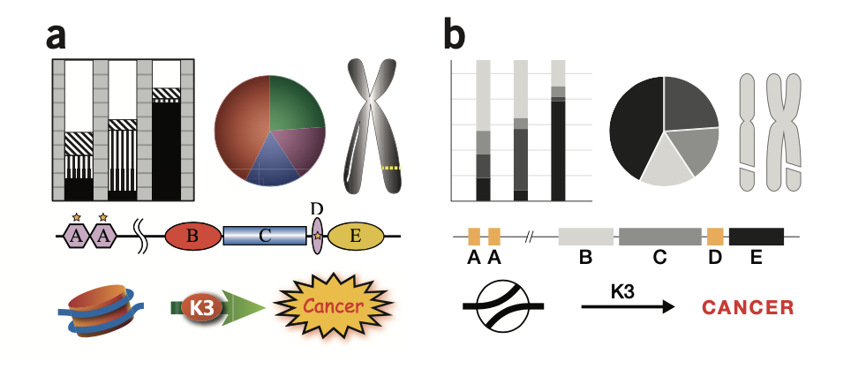
Which data visualization do you prefer? Why?
Practice
(Credit: Martin Krzywinski, Nature Methods 2013)

Slide 34
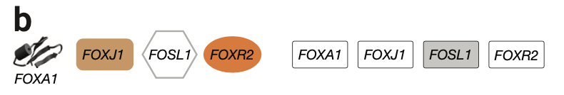
Which data visualization do you prefer? Why?
Practice
(Credit: Martin Krzywinski, Nature Methods 2013)

Slide 35
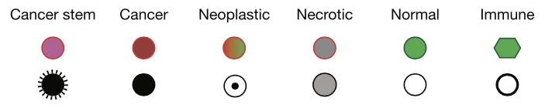
Which data visualization do you prefer? Why?
Practice
(Credit: Martin Krzywinski, Nature Methods 2013)

Slide 36
Additional Reading
https://towardsdatascience.com/the-art-and-science-of-data-visualization-6f9d706d673e

